Slide 1
Week 2 Review
Week 2, Day 5

Slide 2
Announcements
Quiz today! (Do you guys have a pen?)
Futsal Today – Ethitogether vs Future Designers
Female Futsal Team (Futsal O Football X)
Final Project Group
Codeacademy (Strongly Recommended!!)
After Quiz - Korean Culture Today!
Github

Slide 3
What did we learn this week?
HTML – structure of the website
CSS – styling of the website
JavaScript – making functions/events of the website
DOM - Changing HTML and CSS elements using JavaScript

Slide 4
HTML
Defining Structure

Slide 5
HTML
Uses Tags (ex) <h1></h1>)
<!DOCTYPE>
Declares the version of HTML
<html>
Container for the document
<head>
A section to declare settings of the webpage
<title>
Title of the webpage
<body>
All visible elements of the webpage
Basic Structure:
<!DOCTYPE html>
<html>
<head>
<title>Name of the website</title>
Links, scripts, title, etc
</head>
<body>
Any visible structure like paragraph
</body>
</html>

Slide 6
Elements
The individual component of HTML
In the <body>!
Many types, but know these:
Heading: <h1> ~ <h6> depending on size
Paragraph: <p> for paragraphs
Div: <div> an empty container
Anchors: <a> links things
Remember to use a closing tag for these!
Also, line breaks: <br>
Usage:
<!DOCTYPE html>
<html>
<head>
<title>Name of the website</title>
</head>
<body>
<h1>I’m the heading</h1>
<p>I’m a paragraph</p>
<div>
<a href=https://www.google.com></a>
</div>
</body>
</html>

Slide 7
Elements with Attributes
Attributes: gives more info about the element
Name=“value”
ALWAYS in the starting tag
Elements:
Images: source (src) is the attribute, image file name is the value
Links: href is the attribute, url is the value
Images with Links
Put image between anchors
Usage:
<!DOCTYPE html>
<html>
<head>
<title>Name of the website</title>
</head>
<body>
<img src=“img_name.jpg”>
<a href=“https://www.a.com”>Link</a>
<a href=“https://www.a.com”>
<img src=“img_name.jpg”>
</a>
</body>
</html>

Slide 8
Lists
Unordered
Unordered list: <ul></ul>
Each list element: <li></li>
Represented by bullet points
<ul>
<li>Semira</li>
<li>Abdu</li>
</ul>
Ordered
Ordered list: <ol></ol>
Attribute: <ol type=“1”></ol>
Each list element: <li></li>
Represented by 1, i, I, a, A
<ol type=“a”>
<li>Mekebib</li>
<li>Tizita</li>
</ol>

Slide 9
Table
Uses <table></table>
<tr>: row
<td>: column
<th>: table heading
Usage:
<body>
<table>
<tr>
<th>first</th>
<th>last</th>
</tr>
<tr>
<td>Habib</td>
<td>Nuredin</td>
</tr>
</table>
</body>

Slide 10
Div Element
An empty container element
Useful for applying a specific styling for all elements within <div>
Extremely useful for organizing the css code
For example, put all headings together
<div style=”color:red;”>
…
</div>

Slide 11
Style Attribute
<tagname style=”property:value;”>
Specifies the style of an element
Properties:
background-color
color
font-family
font-size
text-align

Slide 12
CSS
Giving Style

Slide 13
How to use CSS
Three different ways to define CSS styling:
Inline CSS: A single html element using style attribute
Internal CSS: CSS styling within the same html file
External CSS: CSS styling in a separate file (BEST)

Slide 14
External CSS
Identical to internal CSS, except for the location of the CSS code
CSS styling defined in an external .css file and linked in HTML <head>
BEST practice for defining CSS!
Use external CSS whenever possible
HTML file:
<!DOCTYPE html>
<head> <link rel="stylesheet" type=“text/css” href="styles.css"> </head>
<body>
</body>
</html>
CSS file:
h1 {
color: blue;
}
p {
color: red;
}

Slide 15
How to link the HTML and CSS file
<link rel="stylesheet" type=“text/css” href="styles.css">
rel: relationship between html and css
type: type of document being linked
href: should indicate the path or the address to the css file (the css file name)
<!DOCTYPE html>
<head> <link rel="stylesheet" type=“text/css” href="styles.css"> </head>

Slide 16
Syntax
Consists of selectors and declaration blocks
Selector: h1
Curly brackets
Each declaration consists of property and value
Property: color, font-size
Value: blue, 12px
Needs a semicolon at the end

Slide 17
Syntax

Slide 18
Selectors
Allows CSS to locate the appropriate HTML elements
Four types of selectors:
Universal selector
Element selector
Id selector
Class selector
h1 {
color:blue;
font-size:12px;
}
h1 is an example of an element selector.

Slide 19
Universal Selector
Selects every element from the webpage and applies the style
Uses *
* {
color: red;
border: 1px solid;
}

Slide 20
Id Selectors
Finds HTML elements based on their “id” attribute
Call with #
Each id should be unique in a page
Only one element with a particular id
No more than one id per element
HTML file:
...
<p id=”para1”>hello</p>
...
CSS file:
#para1 {
text-align:center;
color:red;
}

Slide 21
Class Selectors
Finds HTML elements based on their “class” attribute
Not unique
Multiple elements in a same class
Each element can be in multiple classes
HTML file:
<body>
<p class=”para2 para3”>hello</p>
</body>
CSS file:
.para2 {
text-align: center;
color: red;
}

Slide 22
Other Selector Specifications
Specifying HTML element types of a particular class
Grouping multiple selectors
p.center {
...
}
h1, h2, p.center {
...
}

Slide 23
Declarations
Pairs of properties and values
Properties:
background-color
color
font-family
font-size
text-align
and more
h1 {
color:blue;
font-size:12px;
}

Slide 24
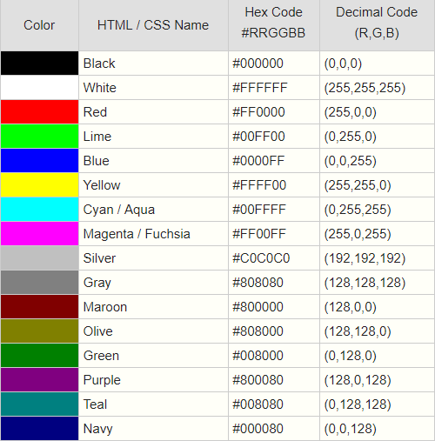
Colors
Different ways to represent color
Valid name: red
RGB value: rgb (255, 0, 0)
HEX value: #FF0000
h2 { background-color:#FF0000; color:rgb(255, 255, 255); }

Slide 25
Fonts
Can change the type, size, bold, italics, spacing, etc
Relevant Properties:
font-family: typeface
font-size: size of the letter
line-height: space between each line
text-align: where the text goes (left, center, right)
word-spacing: space between each word
letter-spacing: space between each letter
font-style: italics, bold, etc

Slide 26
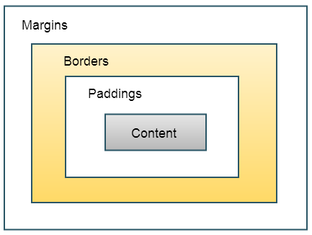
CSS Box Model
Relevant properties:
margin: thickness of the margin
border: style of the borders
padding: extra space
width: how wide the box is (px)
height: how tall the box is (px)
overflow

Slide 27
CSS Box Model
Properties width and height specifies the size of only the content
Uses <div>
CSS file:
div { background-color: lightgrey; width: 300px; border: 25px solid green; padding: 25px; margin: 25px; }
HTML file:
<body>
<div>Hello</div>
</body>

Slide 28
JavaScript
Making functions and events

Slide 29
Intro to JavaScript
JS is a programming language that enables dynamic changes to your HTML webpage
Basic syntax is similar to Python
Special syntax when referring to the objects in HTML
var x, y, z;
x = 5;
y = -5;
z = x + y;
document.getElementById('demo').innerHTML

Slide 30
Variables
Container for storing value
Naming rules:
Contain letters, digits, underscores, and dollar signs
Names cannot start with a digit
Names are case sensitive
Reserved words (if, else, while, etc.) cannot be used
Python:
x = 5
x = 3
JS:
var x = 5;
x = 3;

Slide 31
Variables
Declaration
tell the computer that x is now a variable
Assignment
tell the computer that x is now assigned with the value of 5
Declaration and assignment can be performed in one statement.
In Python, you did not have to explicitly declare variables.
var x;
x = 5;
var y = 4;

Slide 32
Data Types: Primitive Data
Numbers
Can perform operations such as +, -, *, /
Strings
Can use double or single quotation marks
Can perform concatenation operation +
Booleans
true or false
Can perform operations such as &&, ||, !
JS variables are type-dynamic.
Var x = 5 * 3;
x = “Hello world”;
x = true && !false;

Slide 33
Data Types: Objects
An object is a set of properties and methods
Each property and function is separated by comma
objectName.propertyName
objectName.methodName()
var hubo = {
x: 1,
direction: ”east”,
move: function() {
this.x += 1;
}
};
location = hubo.x;
hubo.move();
location = hubo.x;

Slide 34
Syntax
Semicolons at the end of every statement
Curly brackets { } around every code blocks (ex. function)
All JavaScript code can be written in one line.
Python:
def double(n):
answer = 2 * n
return answer
JavaScript:
function double(n) {
var answer = 2 * n;
return answer;
}
function double(n) {var answer = 2 * n; return answer;}

Slide 35
Conditionals
JavaScript Syntax
Conditionals
Conditionals
Brackets
Parentheses
Semicolons
var sum = 2;
if(sum < 5) {
sum++;
}
Sum: 3
Brackets
Parentheses
Semicolons
var sum = 2;
while(sum < 5) {
sum++;
}
Sum: 5
Brackets
Parentheses
Semicolons
var sum = 0;
var i;
for(i = 0; i < 10; i++) {
sum += i;
}
Sum: 37

Slide 36
External JavaScript
Identical to internal JS, except for the location of the JS code
JS styling defined in an external .css file and linked in HTML <head>
Best practice for defining JS!
Use external JS whenever possible
HTML file:
...
<head> <script src="code.js"></script> </head>
...
code.js:
function demofunc() {
console.log(“hello”);
}

Slide 37
Output
Browser console
Alert
innerHTML
window.alert(“hello”);
console.log(“hello”);
document.getElementById(“id1”).innerHTML;

Slide 38
Output: Browser Console
Press “f12” in Chrome to access the console
Used for debugging (not for users)
var x = 5;
x += 2;
console.log(x);

Slide 39
Output: Alert
Creates a popup that alerts the users with a message
Not a good practice to use frequently
window.alert(“hello”);

Slide 40
Output: innerHTML
You can use JavaScript to read and change the contents of HTML elements
document.getElementById(“id_name”) obtains the object representing HTML element
innerHTML property gets the contents of the element
HTML:
<p id=“id1”>Hello, world<p>
JavaScript:
console.log(document.getElementById(“id1”));
document.getElementById(“id1”).innerHTML = “Bye”;

Slide 41
Events
User (or webpage) can create certain “events”
Types of events
onchange, onclick, onmouseover, onmouseout, onload

Slide 42
Events example
Format: <element action=“function(parameter)”></element>
In HTML file:
<h1 onmouseover=“change_name(this)”>Anders</h1>
IN JS file:
function change_color(ele) {
ele.innerHTML = “Julie”;
}

Slide 43
Events example
Format: <element action=“function(parameter)”></element>
In HTML file:
<h2 id=“id_1”>Martin</h2>
<h1 onmouseover=“change_name()”>Anders</h1>
IN JS file:
function change_color() {
document.getElementByID(‘id_1’).innerHTML = “Ted”;
}

Slide 44
Events
“this” refers to the current element
Inline JavaScript code usually calls a function (defined in a separate .js file) for simplicity
<h1 onmouseover = "change(this)">Hover mouse here</h1>
function change(ele) {
ele.innerHTML = “Thank you”;
}

Slide 45
JavaScript HTML DOM
Changing HTML and CSS elements using JavaScript

Slide 46
HTML DOM
Document Object Model
Represents HTML elements as JavaScript objects
Allows us to dynamically add, remove, and modify HTML elements and their CSS styles

Slide 47
Element and Content
ELEMENT
.getElementById(“id1”)
A single element
.getElementsByTagName(“p”)
A list of elements
.getElementsByClassName(“class1”)
A list of elements
CONTENT
Changing contents
.innerHTML property of the element
Changing attribute values
.attributename property
Style
.style.property

Slide 48
Good Luck!

